Slide 1
Predicting Collision Severity in Seattle
IBM and Coursera Applied Data Science Capstone Project
Tom Walter, 04 September 2020

Slide 2
1.Introduction: Problem & Goal
Problem:
accident collisions cause property damage, injury, or death
since cars invented, many auto safety measures followed:
manufacturers: seatbelts & airbags
civil engineers: guard rails & traffic lights
government: traffic laws & enforcement (speeding, drunk driving, etc.)
US road accident deaths at all time low
BUT: every collision remains public health risk!
Goal:
Machine Learning: Classification
predict severity class
identify causes of severe collisions
help reduce severity & total number of accidents
Deployment Options:
electronic warning signs
road improvements
future: feed data to AI cars
Make drivers & pedestrians saver!

Slide 3
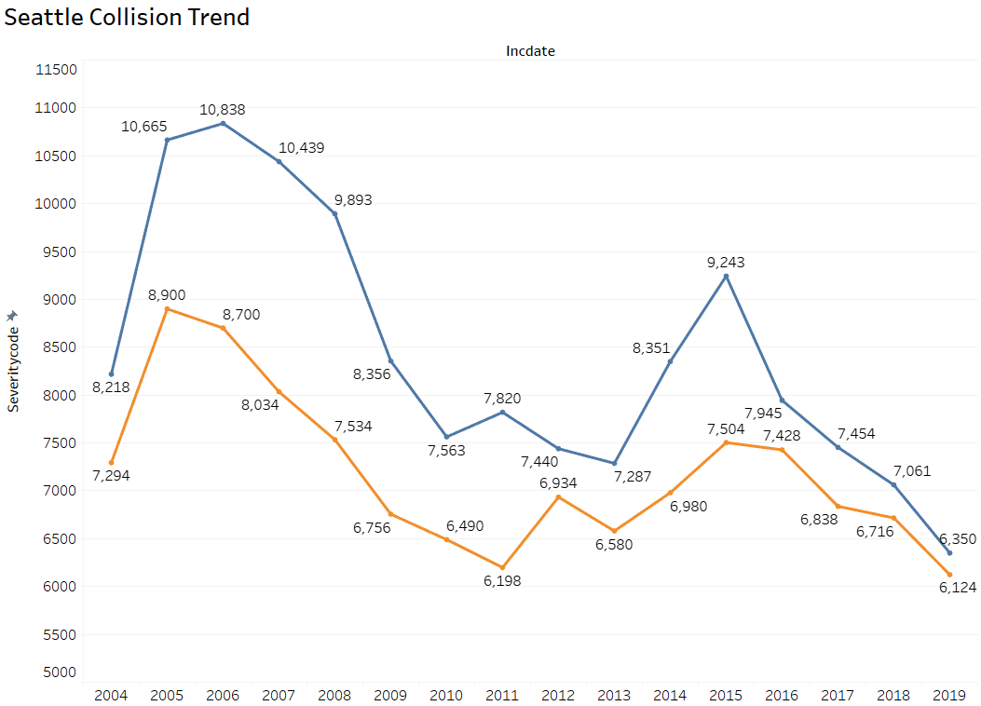

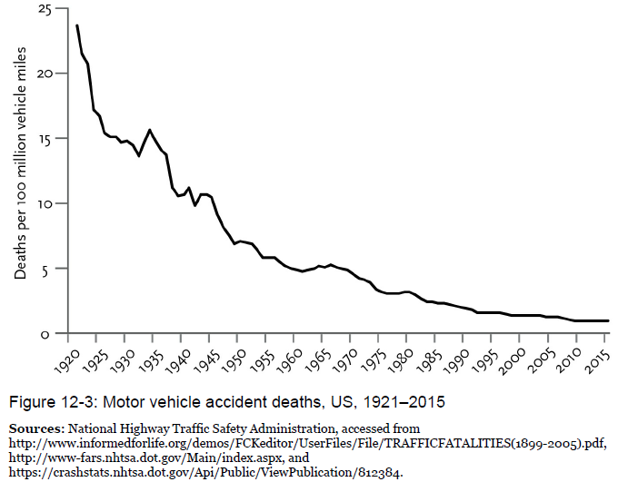
US Decline in Accident Severity
US Road Accident Deaths

Slide 4
2. Data, Hypothesis, & Feature Selection
Dataset:
Collision Data by SDOT Traffic Management Division in Seattle, WA
from 2004 to 2020
194,673 reported collisions
38 attributes about collisions
unnecessary features dropped
Hypothesis:
severity of collision is a function adverse driving conditions and negligent human behavior
Table 1: Pre-Selected Features
 | Feature | Description
1 | SEVERITYCODE | severity class of the collision: 1 = property damage 2 = injury collision
2 | LONGITUDE | longitude
3 | LATITUDE | latitude
4 | JUNCTIONTYPE | category of junction
5 | WEATHER | weather conditions
6 | ROADCOND | road conditions
7 | LIGHTCOND | light conditions
8 | INCDATE | date of the incident
9 | INDTTME | date & time of the incident
10 | INATTENTIONIND | whether collision was due to inattention
11 | UNDERINFL | whether driver was under the influence of drugs/ alcohol
12 | SPEEDING | whether speeding was a factor in the collision
y = severity class
y = f(x) = driving conditions + human behavior + timing

Slide 5
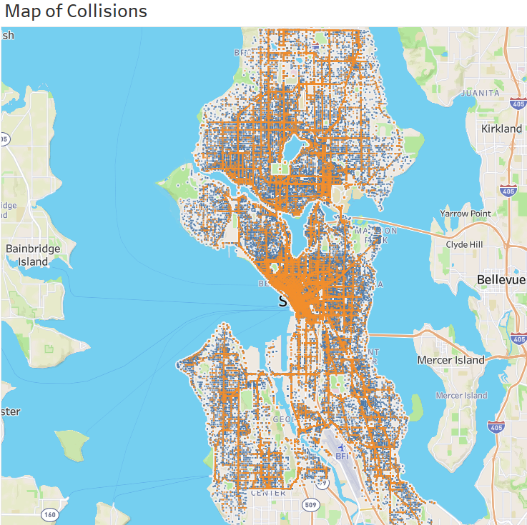
3. Exploratory Data Analysis
Driving Conditions - Location
LONGITUDE and LATITUDE pinpoint collisions on map
missing values are replaced by mean

Slide 6
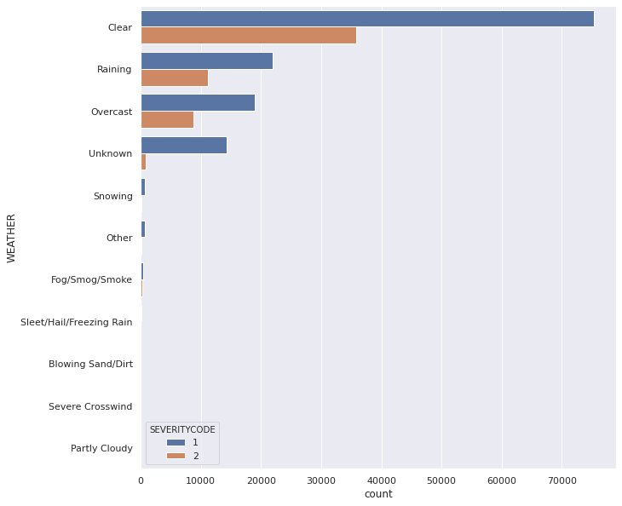
3. Exploratory Data Analysis
Driving Conditions - Weather
mode = clear weather
mode will replace 5,081 missing values
worse weather ≠ worse collision
counter-intuitive conclusion

Slide 7
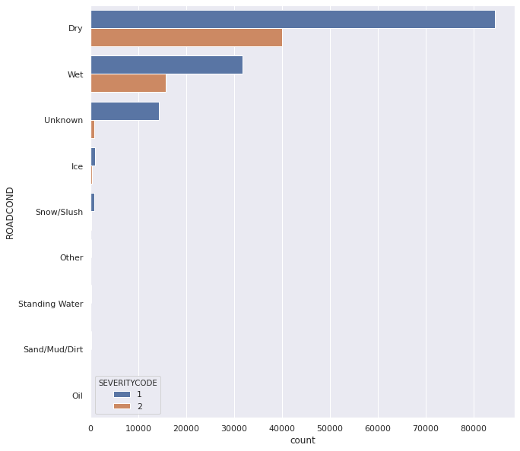
3. Exploratory Data Analysis
Driving Conditions - Road
mode = dry roads
mode will replace 5,012 missing values
worse road ≠ worse collisions
counter-intuitive conclusion

Slide 8
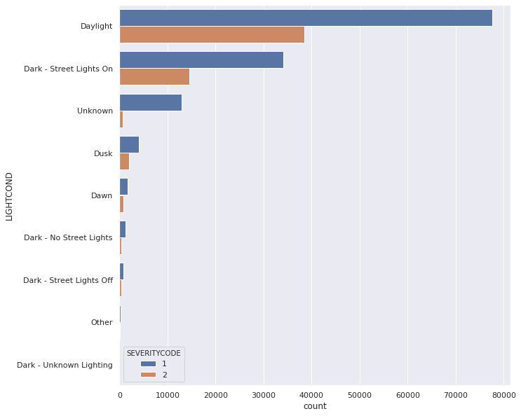
3. Exploratory Data Analysis
Driving Conditions - Light
mode = daylight
mode will replace 5,170 missing values
worse lighting ≠ worse collisions
counter-intuitive conclusion

Slide 9
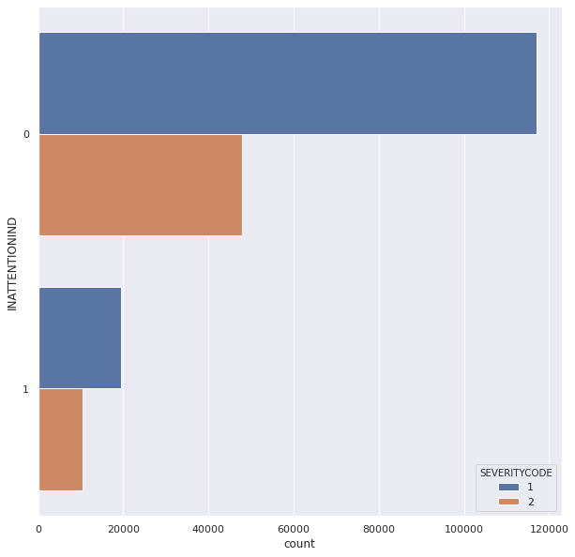
3. Exploratory Data Analysis
Human Behavior - Inattention
mode = no
mode will replace 164,868 missing values
most accidents happen even when people pay attention
counter-intuitive conclusion

Slide 10
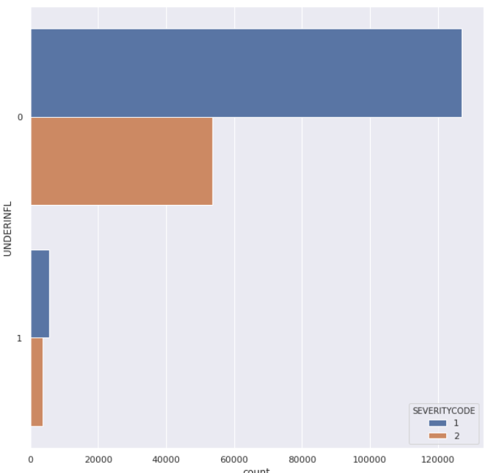
3. Exploratory Data Analysis
Human Behavior – Alcohol/Drugs
mode = no
mode will replace 4,884 missing values
most accidents happen when people are sober
counter-intuitive conclusion

Slide 11
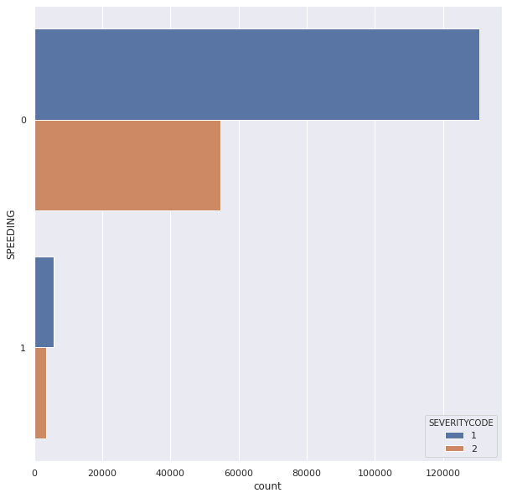
3. Exploratory Data Analysis
Human Behavior – Speeding
mode = no
mode will replace 185,340 missing values
most accidents happen when people obey speed limit
counter-intuitive conclusion

Slide 12
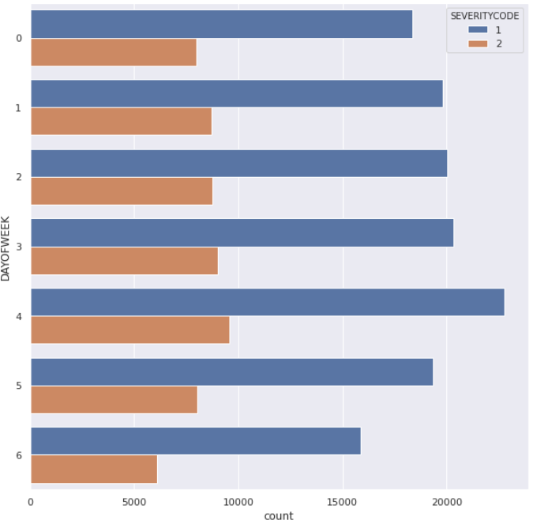
3. Exploratory Data Analysis
Timing – Day of the Week
mode = Friday
more accidents happen during workdays than on weekends
intuitive conclusion
(0 = Monday, 1 = Tuesday, 2 = Wednesday, 3 = Thursday, 4 = Friday, 5 = Saturday, 6 = Sunday)

Slide 13
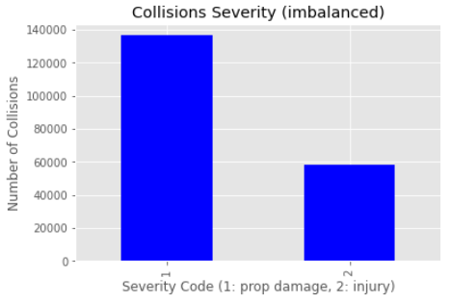
4. Machine Learning
Balancing the Dataset
total collisions = 194,673
class 1 = 58,188
class 2 = 136,485
imbalance will bias machine learning to majority class
Random Under Sampling is used for balancing labels
58,188 (class 1) + 58,188 (class 2) = 116,376 cases for ML

Slide 14
4. Machine Learning
assumption = combination of independent features in dataset will have recurring patterns connected to severity class
ML will find the patterns & combination of features that ‘predict’ severity class
other application of ML classification
spam, fraud, & churn prediction
handwriting & face-recognition
extreme events
medical diagnosis
common classification algorithms:
K-Nearest Neighbors
Decision Tree
Random Forest
Logistic Regression
Artificial Neural Networks

Slide 15
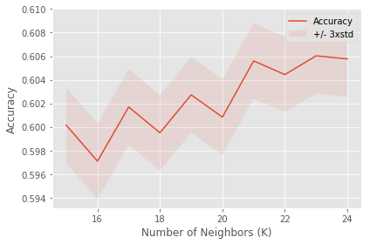
4. Machine Learning
K-Nearest Neighbors (KNN)
stores all cases and classifies a new case based on its similarity to its ‘nearest neighbors’
e.g. an unknown case is compared to 5 neighbor cases
3/5 neighbors are class 2
2/5 neighbors are class 1
unknown case classified as class 2
find best K=number of neighbors
best general accuracy of 0.6060 with k=23

Slide 16
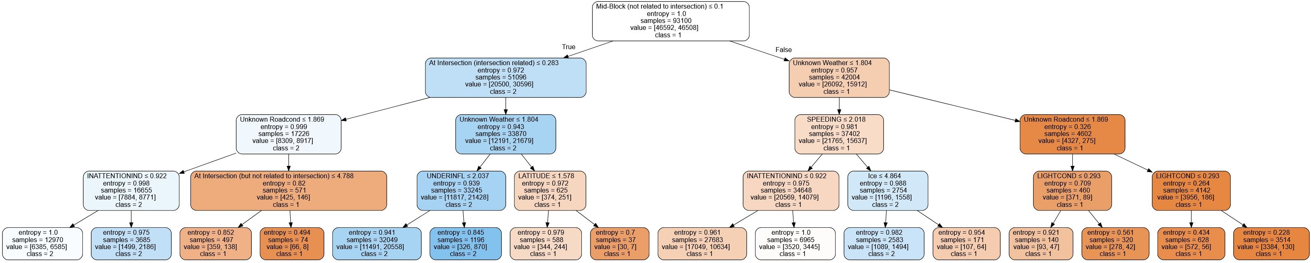
4. Machine Learning
Decision Tree
are called tree
leaves = class labels
branches = conjunctions of features
leaves are pure when completely homogenous (no more entropy)
trees mimic human decisions
general accuracy = 0.5719
example tree below (max depth=4)

Slide 17
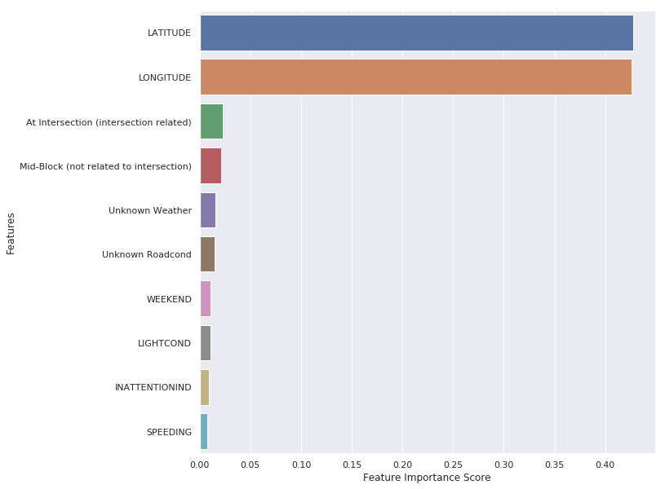
4. Machine Learning
Random Forrest
are called forest:
multiple decision trees
random sub-samples of data
also work on “entropy”
general accuracy = 0.5870
Feature Importance Scoring:
which features most important for outcome

Slide 18
4. Machine Learning
Logistic Regression
common stat. method for binary classification
can also estimate probability of a case falling into a class
provide several solvers:
‘liblinear’
‘SAG’
‘SAGA’
Scores:
liblinear gen. accuracy = 0.6199
SAG gen. accuracy = 0.6199
SAGA gen. accuracy = 0.6199
liblinear is recommended for large-scale and high-dimension dataset

Slide 19
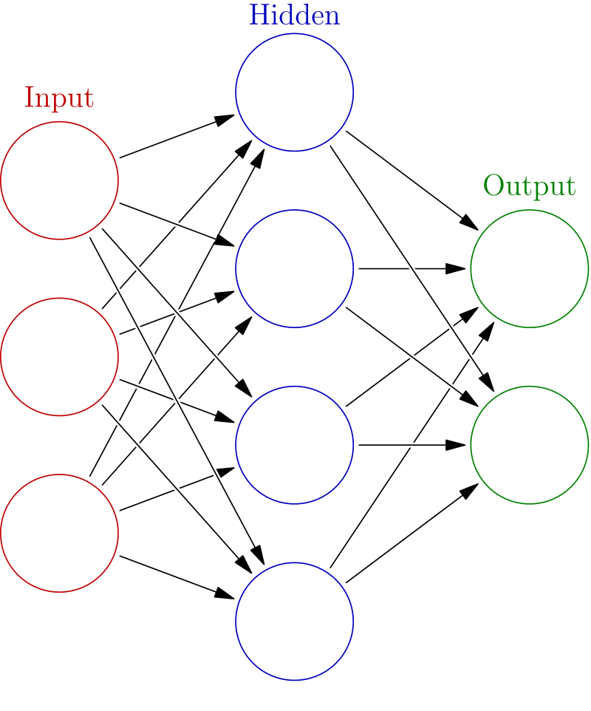
4. Machine Learning
Artificial Neural Networks
loosely mirror neurons in a biological brain
neurons have connections & layers
learning:
layer of neurons receive input data
transform the data
send data to next layer of neurons
Iteration until converge on functions with minimal error
gen. accuracy = 0.6243

Slide 20
5. Evaluation
General Accuracy
% of how many predictions were correct of all prediction
higher = better, range 0-1
Jaccard-Score
% overlap between predicted and actual class sets
higher = better, range 0-1
F1-Score
balance between true positives and false positives
higher = better, range 0-1
Log-Loss
only for models with probability estimation
uncertainty of predicted probability
lower = better, range 0-1
Table 2: Formal Evaluation Metrics
 | Gen. Accuracy | Jaccard-Score | F1-score | Log-Loss
K-Nearest Neighbor | 0.606032 | 0.414656 | 0.605196 | NaN
Decision Tree | 0.571920 | 0.411111 | 0.571595 | NaN
Random Forest | 0.587085 | 0.410946 | 0.587052 | NaN
Logistic Regression | 0.619995 | 0.440933 | 0.619862 | 0.643860
Neural Network | 0.624377 | 0.447345 | 0.624300 | 0.640896
Table 3: Variation in Accuracy Scores
 | Gen. Accuracy | Jaccard-Score | F1-score | Log-Loss
mean | 0.602 | 0.425 | 0.602 | 0.642
std | 0.022 | 0.018 | 0.022 | 0.002

Slide 21
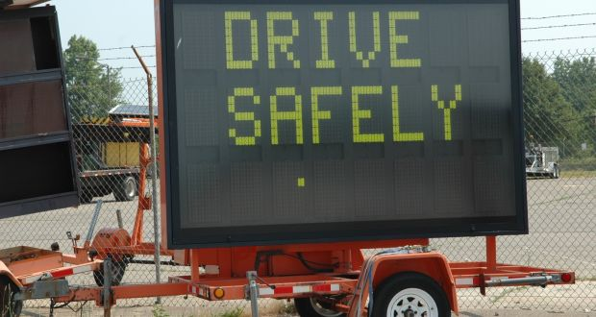
5. Evaluation
Top 3 ML Classification Models:
Artificial Neural Networks
Logistic Regression (liblinear)
K-Nearest Neighbors
Link to the Full Report:
https://github.com/tom-walter/Coursera_Capstone/blob/master/Tom%20Walter%2C%20Full%20Report%20Capstone.pdf

